Slide 1
Ensemble Learning
Dr. Nassim Sohaee

Slide 2
Wisdom of the crowd
Ask a question to thousands of random people, aggregate the answers. The aggregated answer is better than expert answer.
Aggregate the predictions of a group of predictors, often get better predictions than individual predictor.

Slide 3
Ensemble
A group of predictors is called an ensemble.
Example:
train a group of Decision Tree classifiers, each on a different random subset of the training set.
To make predictions, obtain the predictions of all individual trees, then predict the class that gets the most votes.
ensemble of Decision Trees is called a Random Forest
Use Ensemble methods near the end of a project, once you have already built a few good predictors, to combine them into an even better predictor.
the winning solutions in Machine Learning competitions often involve several Ensemble methods (most famously in the Netflix Prize competition).

Slide 4
Ensemble
Diverse set of algorithms
Same algorithm on the diverse set of features
Same algorithm on different set of instances
Boosting
Stacking

Slide 5
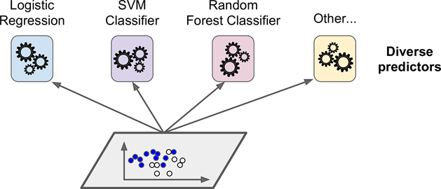
Voting Classifiers
K-Nearest Neighbor Classifier

Slide 6
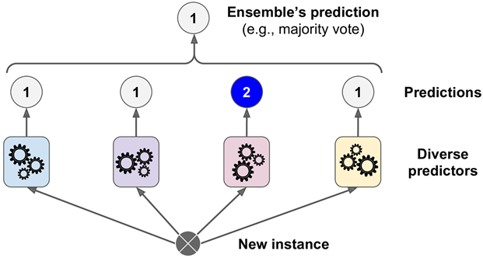
Hard Voting Classifier

Slide 7
Hard Voting Classifier
The ensemble of weak classifiers is often a strong classifier.
Weak classifier: only slightly better than random guessing
Strong classifier: high accuracy

Slide 8
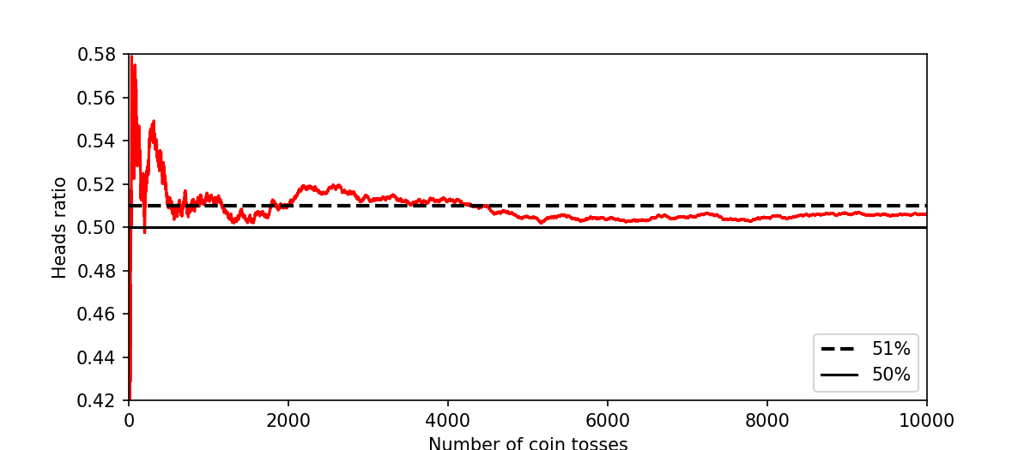
How is this possible?

Slide 9

Voting Classifier
K-Nearest Neighbor Classifier

Slide 10
Law of Large Numbers
Weak learner 1
Weak learner 2
Weak learner 3
Weak learner 1000
…

Slide 11
Soft Voting
Predict the class with the highest class probability, averaged over all the individual classifiers.

Slide 12
Ensemble
Diverse set of algorithms
Same algorithm on the diverse set of features
Same algorithm on different set of instances
Boosting
Stacking

Slide 13
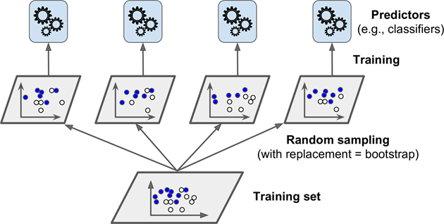
Bagging and Pasting

Slide 14
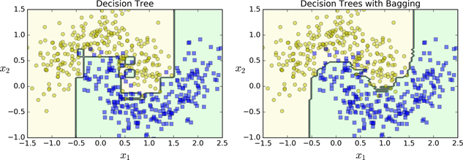
Decision Tree with Bagging and Pasting

Slide 15
Out-Of-Bag Evaluation
On average only 63% of the training instances are sampled in average.
The remaining samples are called out-of-bag (oob) objects.

Slide 16
Ensemble
Diverse set of algorithms
Same algorithm on the diverse set of features
Same algorithm on different set of instances
Boosting
Stacking

Slide 17
Random Patches and Random Subspaces
Random subspace: random sunset of feature set
Random patch: random subset of instance set

Slide 18
Random Forest
An ensemble of decision trees, training via bagging (or pasting)

Slide 19
Feature Importance
Measure the relative importance of each feature.
how much the tree nodes that use that feature reduce impurity on average

Slide 20
Ensemble
Diverse set of algorithms
Same algorithm on the diverse set of features
Same algorithm on different set of instances
Boosting
Stacking

Slide 21
Boosting
AdaBoost
Gradient Boosting

Slide 22
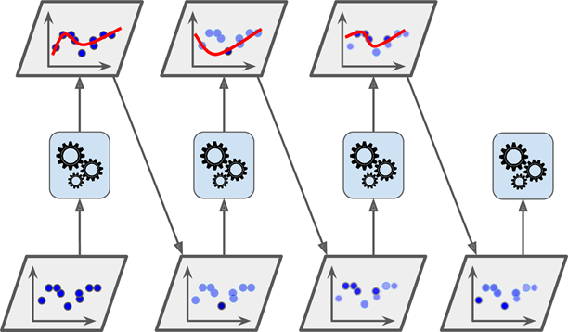
Adaboost

Slide 23
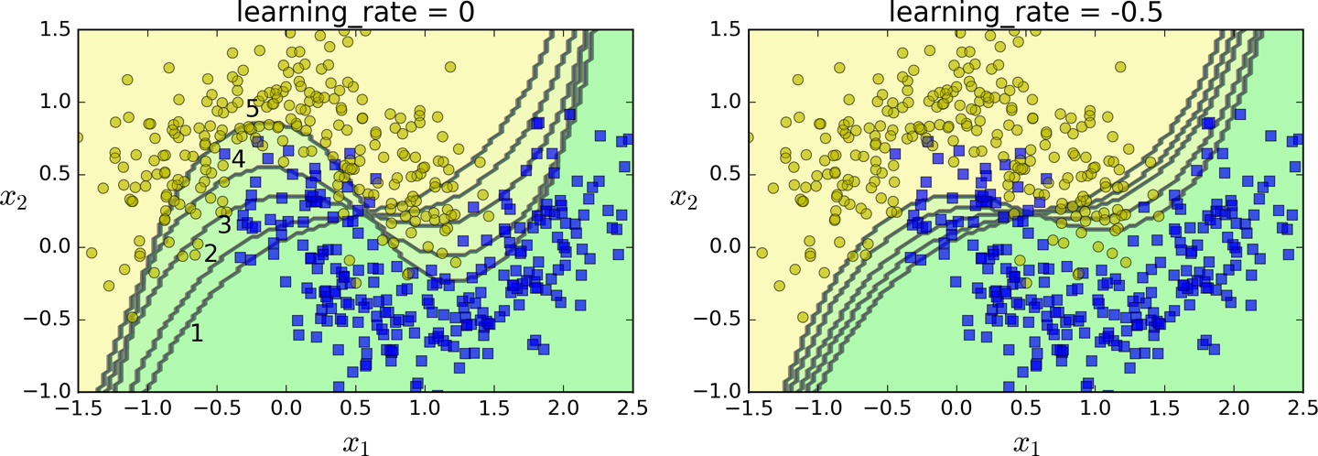
Learning Rate

Slide 24
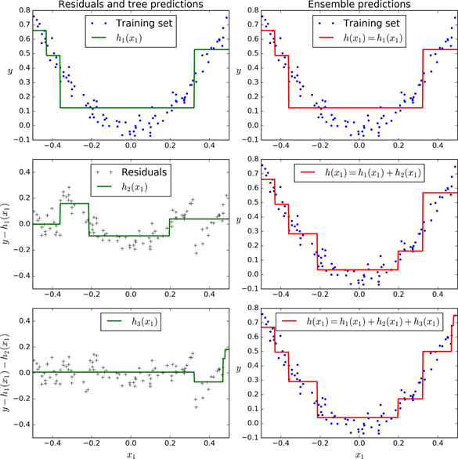
Gradient Boosting

Slide 25
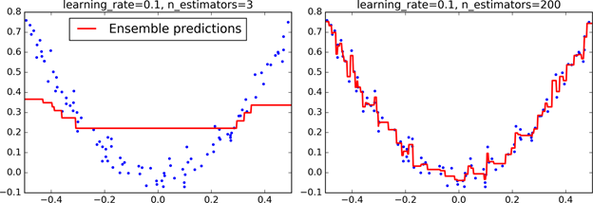

Slide 26
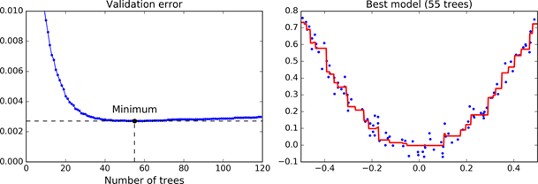

Slide 27
Ensemble
Diverse set of algorithms
Same algorithm on the diverse set of features
Same algorithm on different set of instances
Stacking

Slide 28
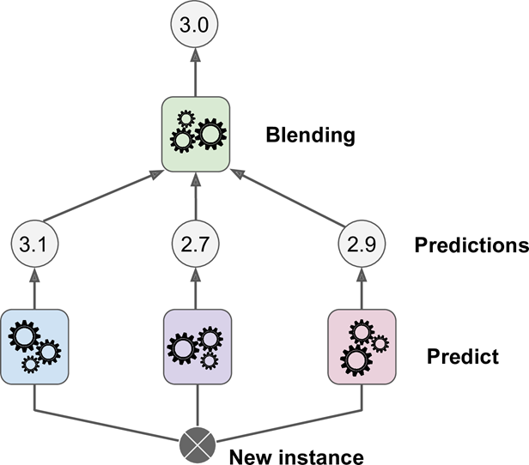
Stacking

Slide 29
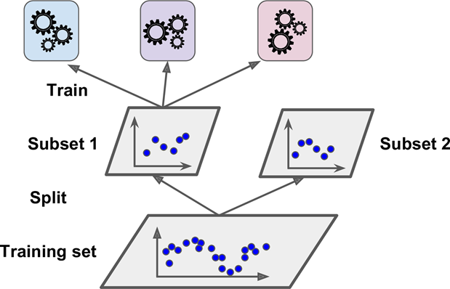
Stacking

Slide 30
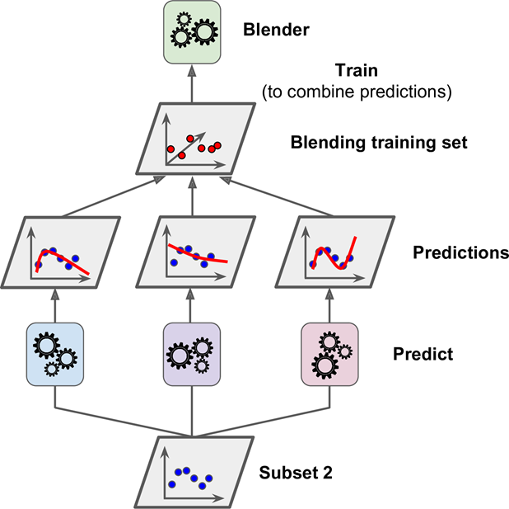

Slide 31
